Slide 1
THE ANATOMY OF AN AMA IMPAIRMENT RATING
Jon C. Walker
Thursday, September 12, 2013
James R. Thompson Center, Chicago, IL
1 Hour General MCLE Credit
WCLA Young Lawyers Section

Slide 2
Chapter 1: Conceptual Foundations and Philosophy Impairment vs. Disability
Impairment: a significant deviation, loss, or loss of use of any body structure or body function in an individual with a health condition, disorder, or disease.
Disability: activity limitations and/or participation restrictions in an individual with a health condition, disorder or disease.
“The relationship between impairment and disability remains both complex and difficult, if not impossible, to predict.” (page 5) “Impairment and disability are complex concepts that are not yet amenable to evidence-based definition.”
(page 9)

Slide 3
Causation
“Typically, in assessing impairment, the physician must determine if the health condition is causally related to an event or exposure.” (page 5)

Slide 4
Chapter 2: Practical Application of the Guides
Only permanent impairment may be rated according the Guides, and only after MMI.
The Guides does not permit the rating of future impairment.
“Although treating physicians may perform on their patients, it is recognized that these are not independent and therefore may be subject to greater scrutiny.” (page 23)

Slide 5
Highest Rating Must Be Used
The method producing the higher rating must be used. (Page 20)
EXAMPLE: With ACL and meniscus tear, ACL gives option of Class 0, 0% impairment.
Meniscus tear 1-25%, cannot be 0%.
Look to see if meniscus tear will offer highest rating even with ACL tear.

Slide 6
Declining Medical Treatment
“There may be circumstances in which a patient either declines or fails to comply with surgical treatment…the physician should estimate the impairment rating would be likely if the patient had cooperated with the treatment recommendations. “ (Page 24)

Slide 7
Aggravation and Apportionment
“Apportionment is an allocation of causation among multiple factors that caused or significantly contributed to the injury or disease and resulting impairment. Apportionment requires a determination of percentage of impairment directly attributable to pre-existing as compared with resulting conditions and directly contributing to the total impairment rating derived.
Physician should find a total impairment and a baseline impairment solely consisting of pre-existing condition – the final rating is derived by subtracting the preexisting condition from the total impairment. (page 25)
The AMA directs the rater to determine the prior disability rating without actually performing the evaluation (Functional History, Physical Examination, Clinical Studies) based on the available medical records.
The old rating is subtracted from the new rating, reaching a final rating.

Slide 8
What the AMA 6th Edition Does Not Take Into Account
Restrictions or Functional Capacity Evaluation. (page 6)
Future problems (Prospective medical treatment, Osteoarthritis, arthritis, joint replacements, deterioration). (page 20, Table 2-1, #11)
Multiple surgeries or number of surgeries or surgery at all.
Multiple injuries (full thickness rotator cuff tear with torn labrum and impingement). (page 387)
Impact on ability to work. “In some cases, the referring source may ask the physician rater to assess the medical impairment’s ability to work. This is beyond the scope of the guides.” (page 24)

Slide 9
Pain and Subjective Complaints
6th Edition takes into account pain and subjective complaints.
The Functional History uses the QuickDash for upper extremities, Lower Limb Questionnaire for lower extremities, Pain and Disability Questionnaire for spinal injuries.
These questionnaires rely on subjective and pain complaints.
“The Guides is based on objective criteria. Subjective complaints (e.g, fatigue, difficulty concentrating, sleep difficulties, and weakness) when not accompanied by demonstrable clinical signs or other independent, measurable abnormalities are generally not given impairment ratings.” (page 24)
Functional History is based on subjective reports that are attributable to impairment. (page 406)

Slide 10
The Components of a 6th Edition Impairment Rating
(1) Diagnosis;
Grade Modifiers:
(2)Functional History;
(3) Physical Examination;
(4) Clinical Studies;
(5) Impairment Calculation and Rating.
Five part process – (1)determine diagnosis, (2)-(4) then add or subtract grade modifiers, (5) finally calculate rating.

Slide 11
Diagnosis Based Impairment: Finding the Grid and Class – Upper +Lower Extremities
The Upper Extremities break down into 4 regional grids: digits/hand, wrist, elbow and shoulder.
The Lower Extremities break down into 3 regional grids: foot/ankle, knee, hip.
Each Regional Grid has 5 classes:
Class 0: no objective problem. 0%
Class 1: mild problem. 1-13%
Class 2: moderate problem. 14-25%
Class 3: severe problem. 25-49%
Class 4: very severe problem approaching total function loss. 50-100%

Slide 12
Diagnosis Based Impairment: Finding the Grid and Class - Spine
The spine breaks down into 3 regional grids: cervical spine, thoracic spine, lumbar spine
Each Regional Grid has 5 classes:
Class 0: no objective problem. 0%
Class 1: mild problem. 1-8%
Class 2: moderate problem. 9-14%
Class 3: severe problem. 15-24%
Class 4: very severe problem approaching total function loss. 25-3-%
*thoracic spine (0, 1-6, 7-11, 12-16, 17-22%)

Slide 13
Diagnosis: Regional Grid - Shoulder
Find the correct diagnosis – Table 15.5, page 401-405.
For our practice, usually rotator cuff tear, labral tear, impingement or biceps tear.
All same impairment ranges, 0% or 1-5%, with the exception of full thickness rotator cuff tear (1-7%).

Slide 14
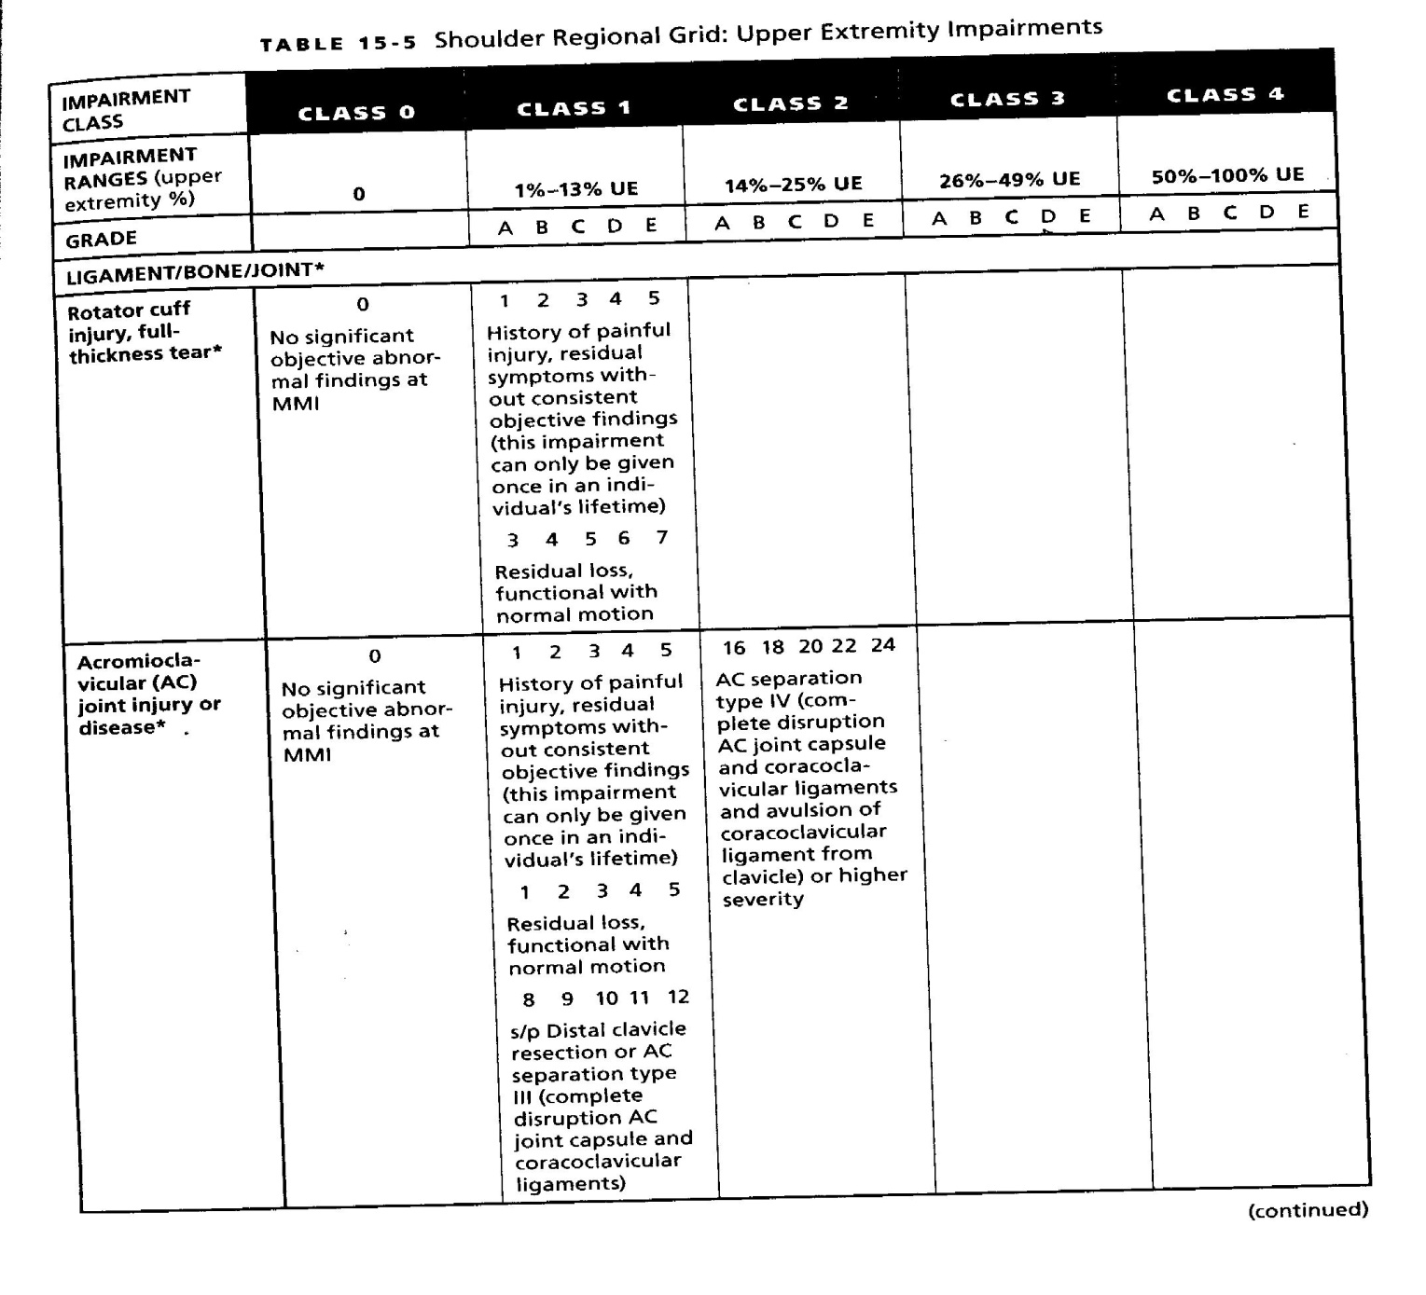

Slide 15
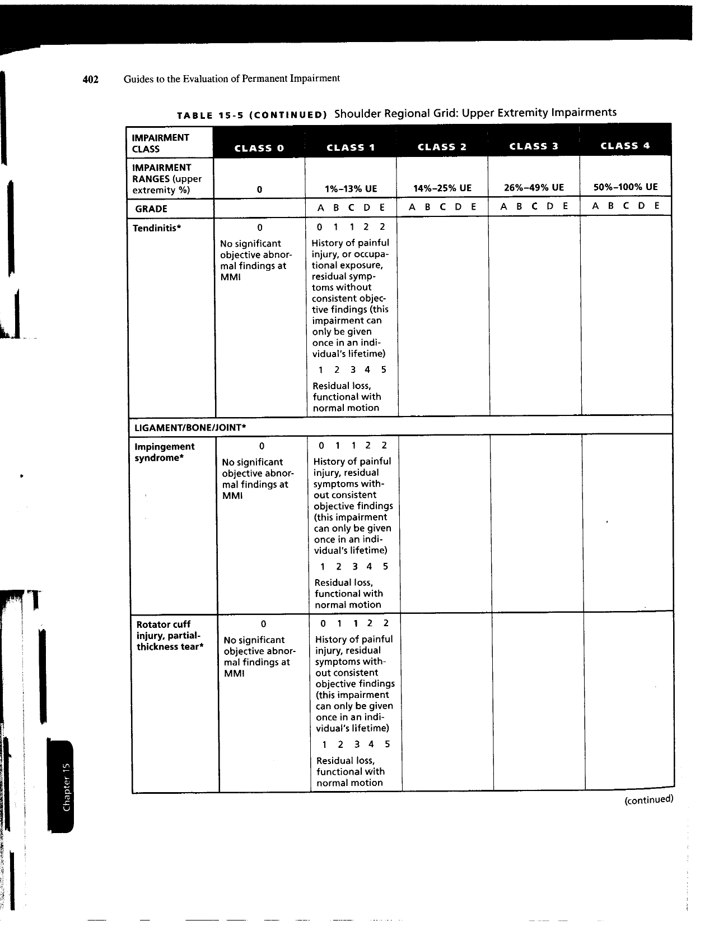

Slide 16
Full Thickness Rotator Cuff Tear
Shoulder Regional Grid: Upper Extremity.
Table 15-5, page 403.
Either class 0 or class 1 (0% or 1-7%) ranges.
Class 1 – Default 3 or 5%.
8-13% impairment is not available for full thickness rotator cuff tear.
Classes 2 - 4 also not available.
* Only exception is where loss of range of motion present, then option to use Section 15.7 or with AC joint/distal clavicle resection.

Slide 17
Common Error – Shoulder Injuries
Common Error! If there is a distal clavicle resection or AC separation type III (complete disruption AC joint capsule and coracoclavicular ligaments) use Table 15.5, page 403 Class 1 – (8-12%).
Usually with Impingement Syndrome.
Look at operative report carefully, if it reads “I elected to proceed with left AC join resection, removing 4 mm of the distal clavicle and acromion…”, then rotator cuff is the incorrect diagnosis.

Slide 18
Diagnosis: Regional Grid - Knee
Find the correct diagnosis – Table 16.3, page 509-511.
For our practice, usually meniscal tear, ACL tear, strain or total knee replacement.
Meniscus (partial meniscectomy 1-3%, total meniscectomy 5-9%, Partial medial and lateral 7-13%, total medial and lateral meniscectomy 19-25%).
ACL tear (0% no instability, 7-13% mild laxity, 14-18% moderate laxity).

Slide 19
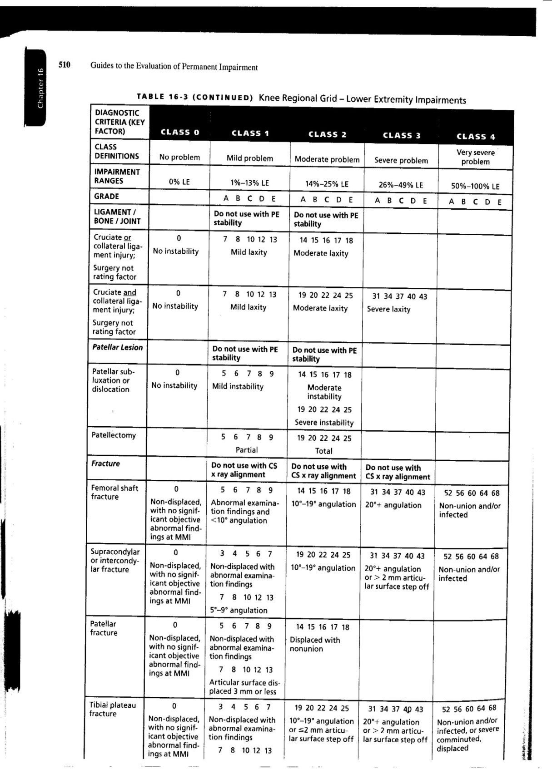

Slide 20
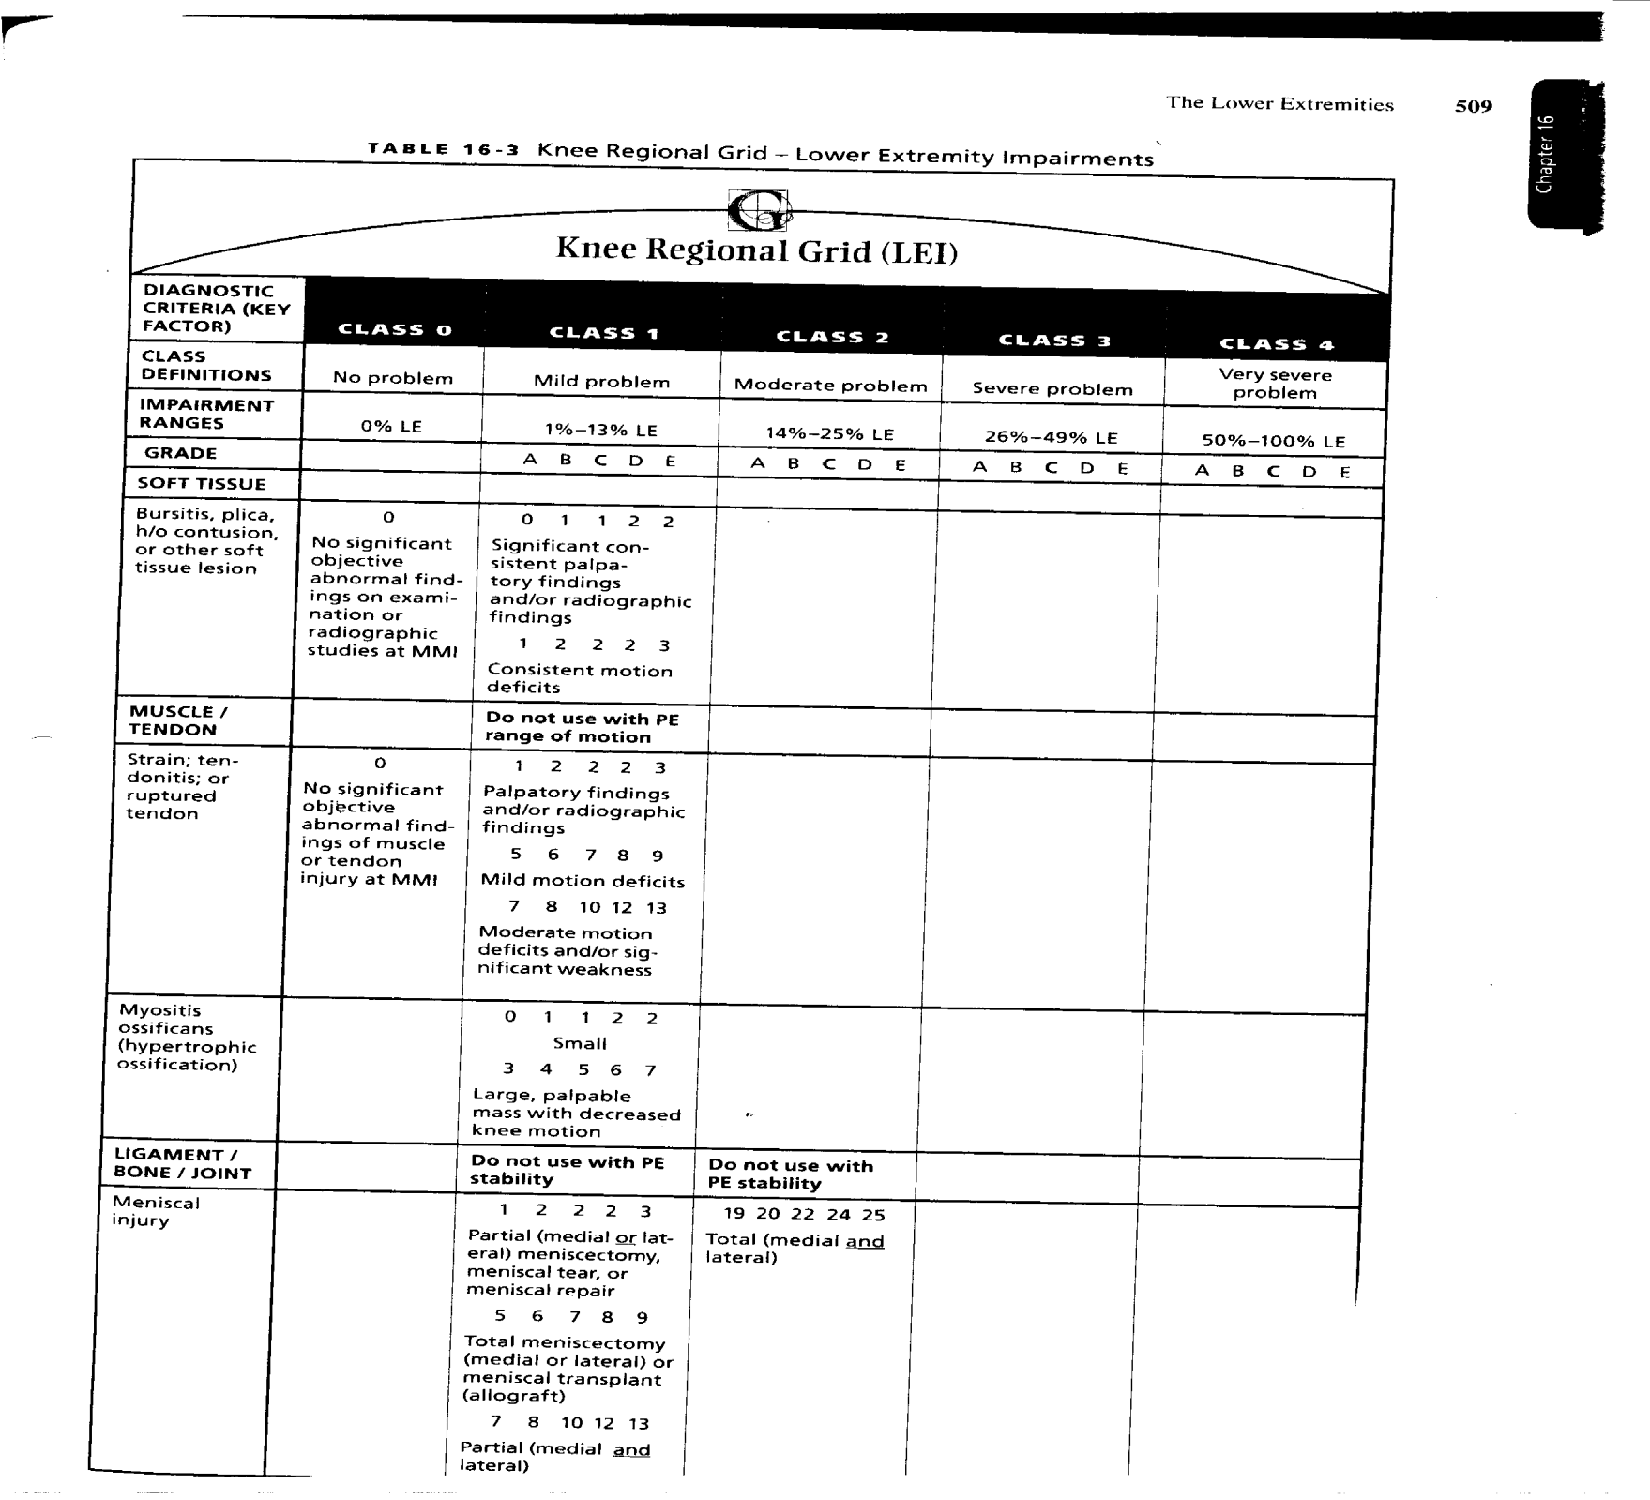

Slide 21
Meniscal Tear
Knee Grid Regional Grid: Lower Extremity.
Table 16-3, page 509.
Class 1 only , cannot be 0%.
Determine if partial medial or lateral meniscectomy, total meniscectomy, partial medial and lateral or total medial and lateral meniscectomy.
Assume partial medial meniscectomy – 1-3%, default 2%.

Slide 22
Common Error – Knee Injuries
ACL tear with partial meniscectomy.
ACL provides 0% impairment if no instability.
Meniscus provides minimum of 1%.
AMA rating cannot be 0% for ACL tear with meniscal tear, even if no instability.

Slide 23
Diagnosis: Regional Grid - Spine
Find the correct diagnosis – Table 17.2-17.4, pages 564-573.
For our practice, usually disk herniation or sprains.
Disk herniations range from 0% or 4-30% impairment.
Radiculopathy and “alteration of motion segment integrity” are key in determining impairment.

Slide 24
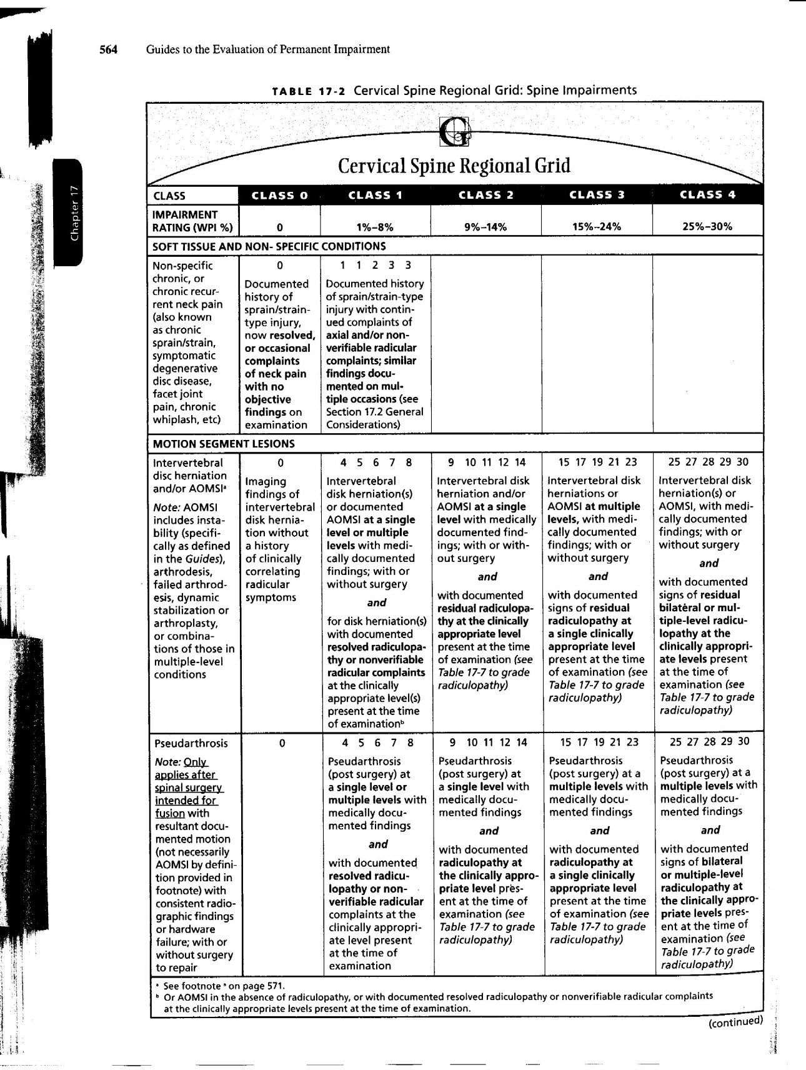

Slide 25
Cervical Disk Herniation
Cervical Spine Regional Grid.
Table 17-2, page 564.
Determine if radiculopathy or AOMSI “alteration of motion segment integrity.”

Slide 26
Grade Modifier #1: Functional History
Functional History is based on subjective reports that are attributable to impairment. (page 406)
For upper extremity injuries, 6th Edition recommends using QuickDash (see attached “The Disabilities of Arm, Shoulder and Hand”).
For lower extremity injuries, 6th Edition recommends using Limb Questionnaire. (see attached)
For Spine injuries, 6th Edition recommends using Pain Disability Questionnaire. (see attached)

Slide 27
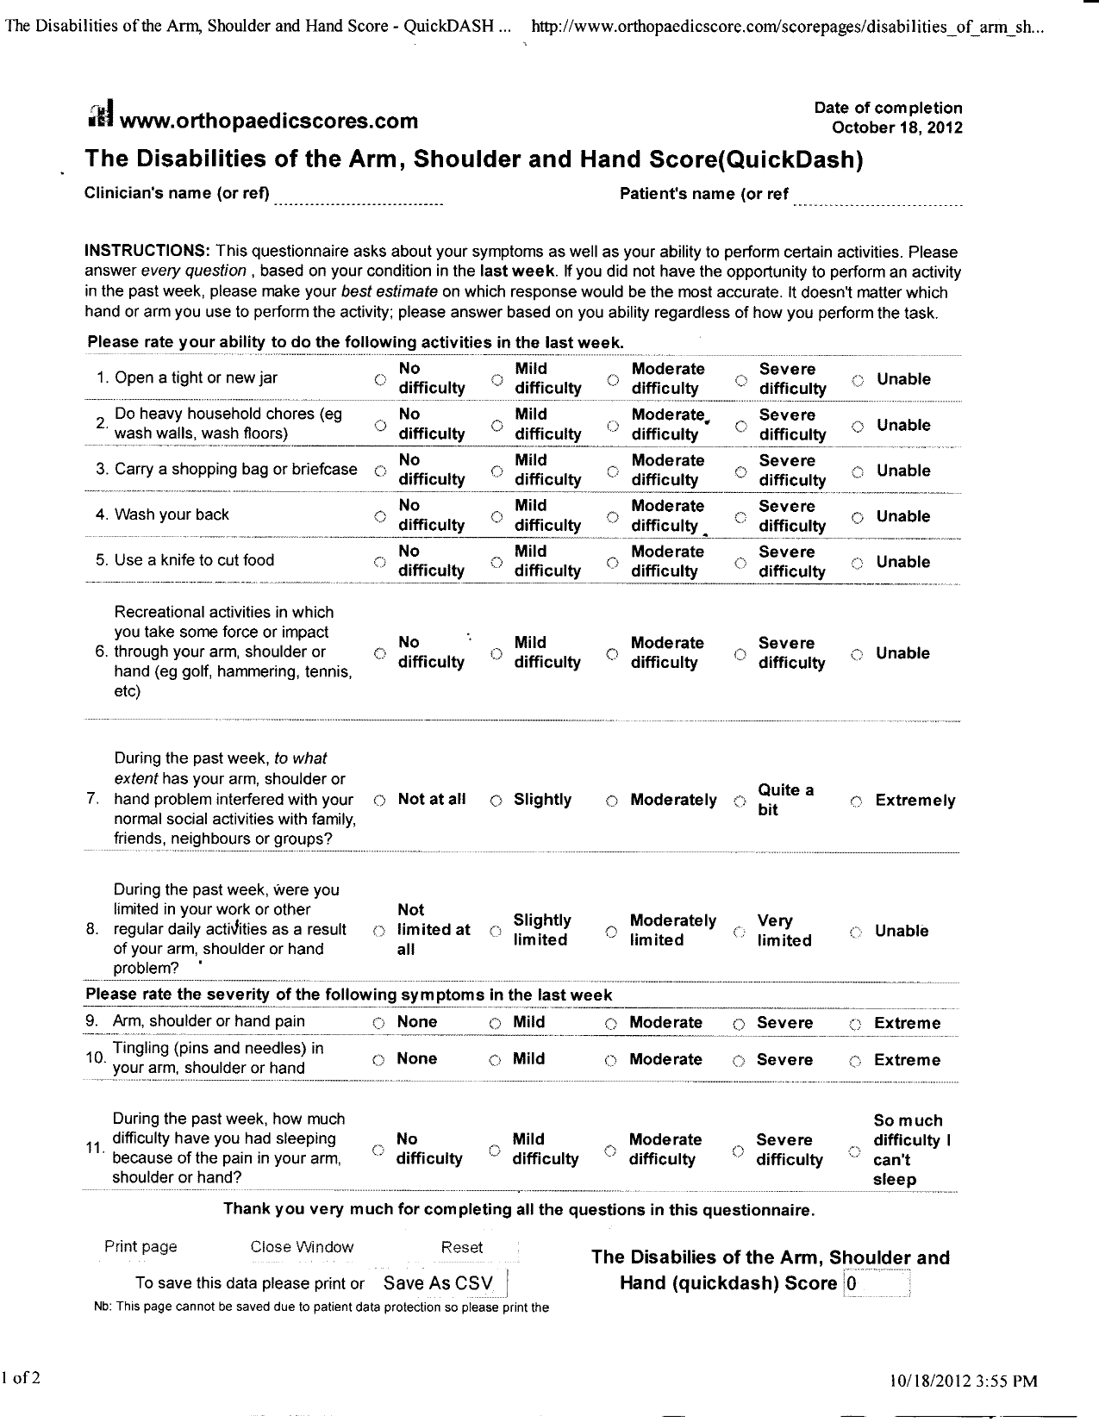

Slide 28
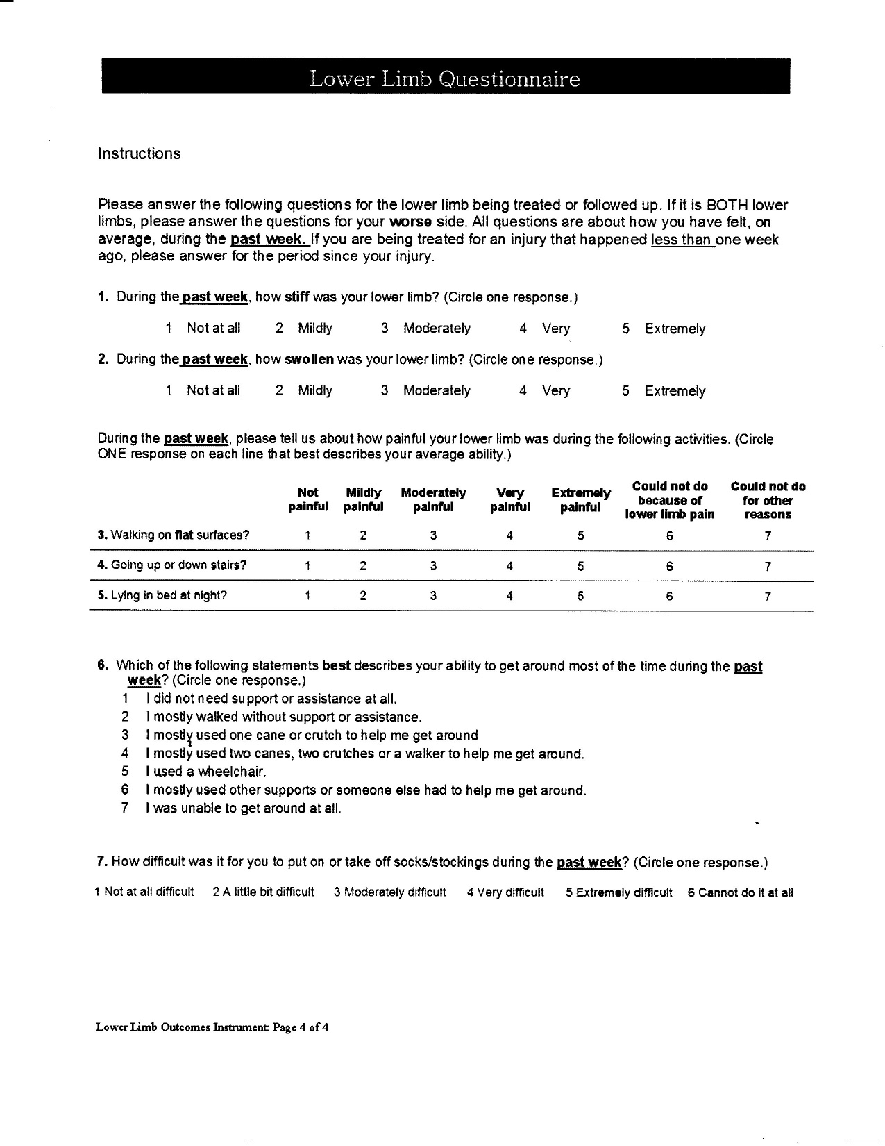

Slide 29
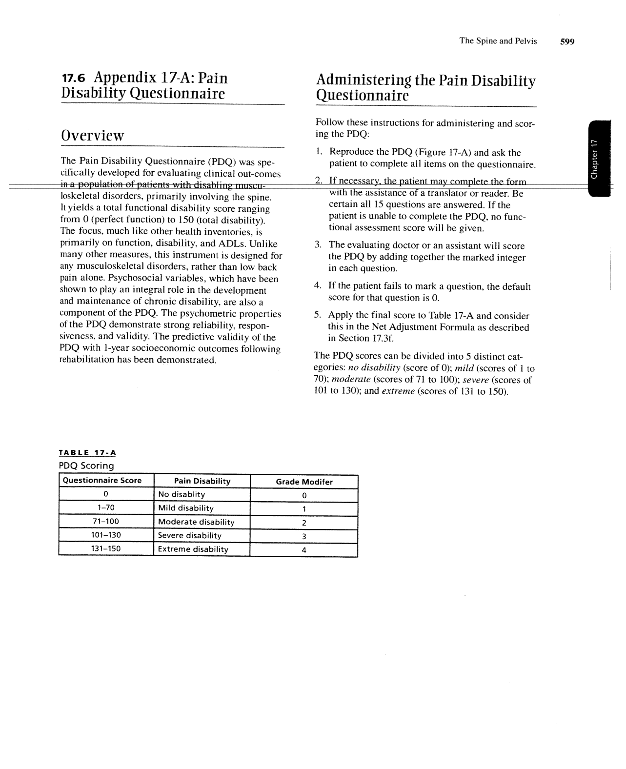

Slide 30
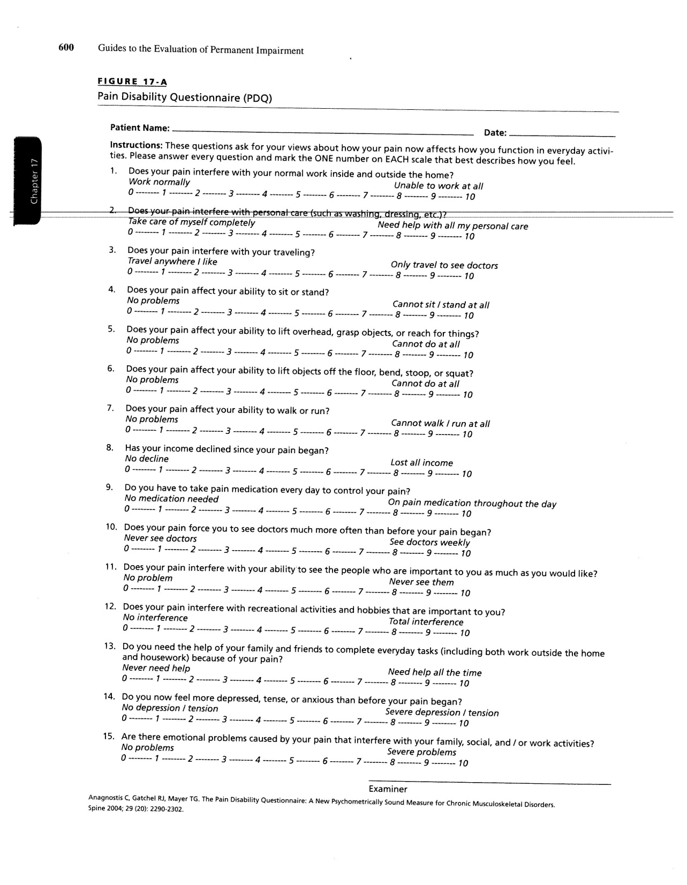

Slide 31
Grade Modifier #2 – Physical Examination
For upper extremity injuries, Table 15-8, page 408. (see attached)
For lower extremity injuries, Table 16-7, page 517.
For spinal injuries, Table 17-7, page 576. (see attached)

Slide 32
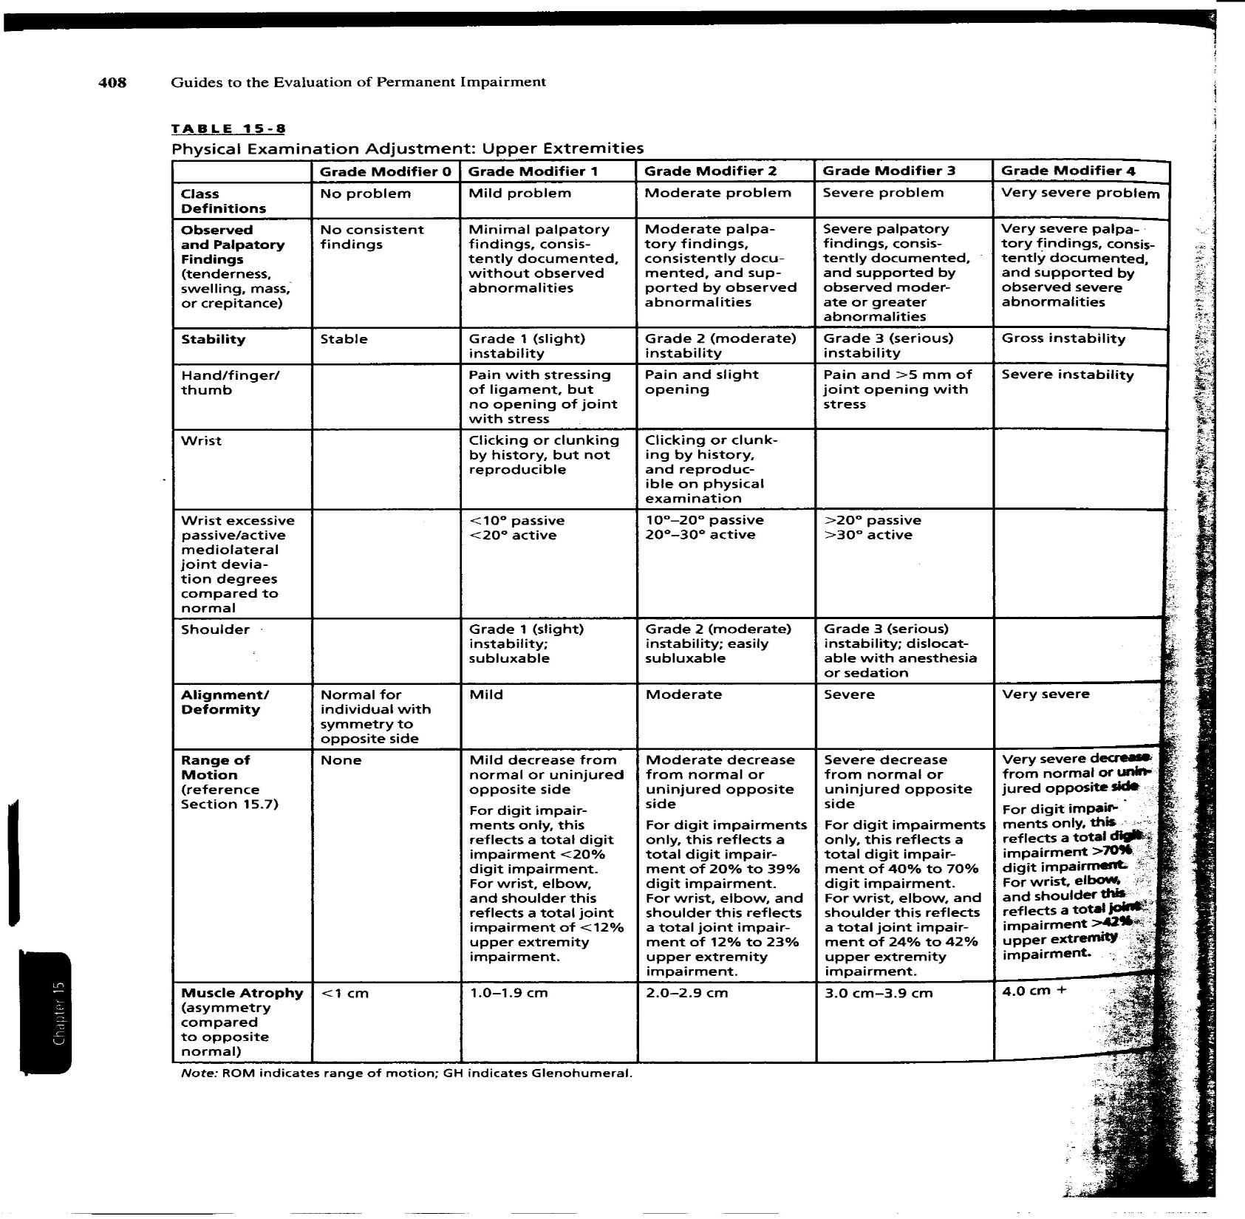

Slide 33
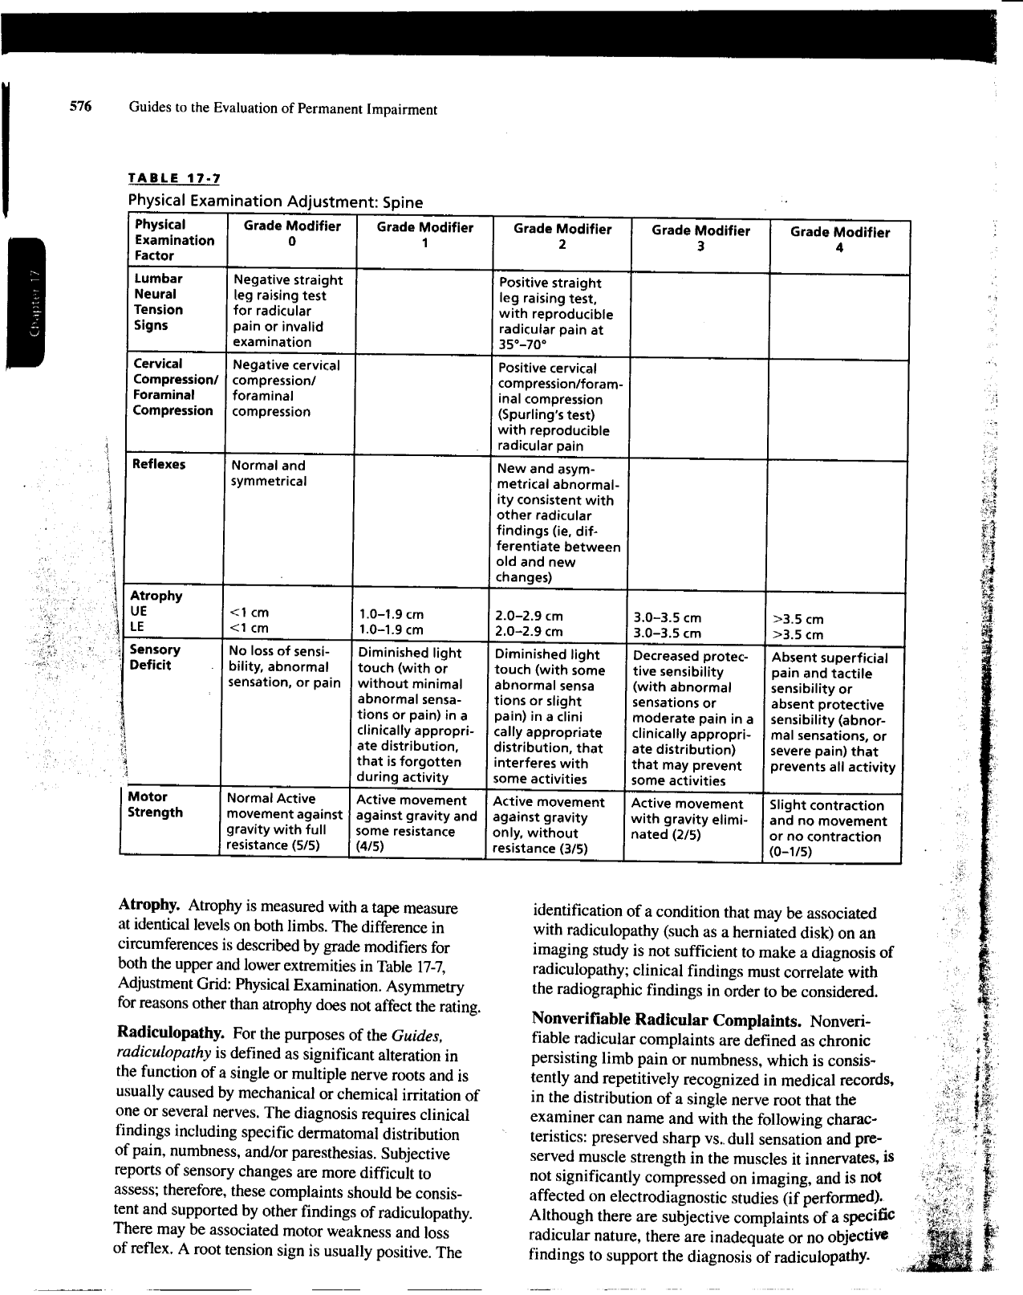

Slide 34
Grade Modifier #3 – Clinical Studies
Clinical Studies indicates special tests such as MRI, X-Ray, EMG/NCV. (page 407)
If Clinical Study used to determine diagnosis, it cannot be used as Grade Modifier. (page 405, 407)
Clinical Study alone does not make diagnosis. (page 407)
This is another common error – since diagnosis could be made with operative report or doctor’s examination, clinical study (MRI) should rarely make diagnosis.

Slide 35
Clinical Study Tables
For upper extremity injuries, Table 15-9, page 410. (see attached)
For lower extremity injuries, Table 16-8, page 519.
For spinal injuries, Table 17-9, page 581.

Slide 36
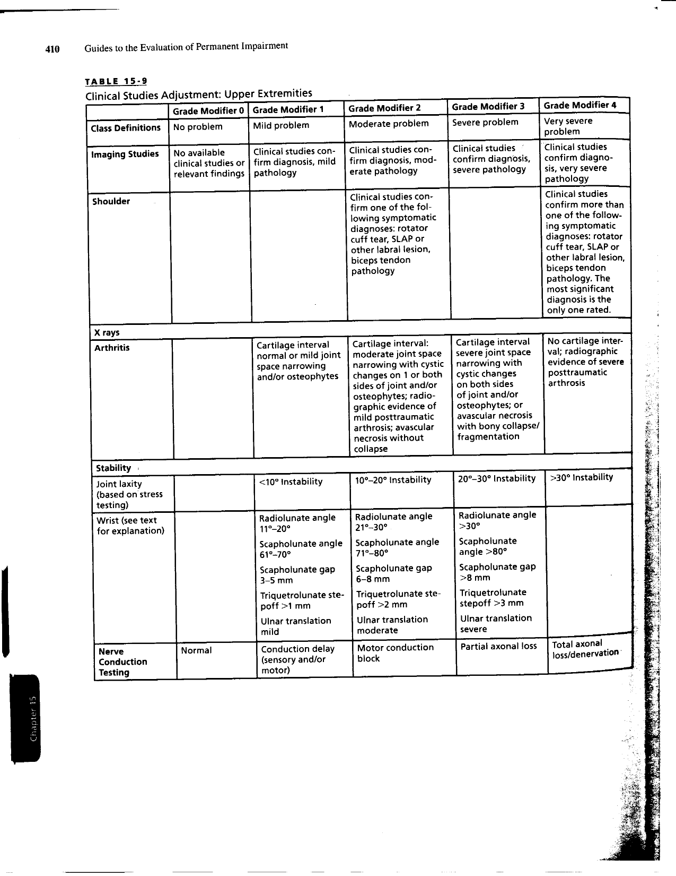

Slide 37
Calculating the Impairment Rating
Start with Default (C) Rating.
Modifiers may increase or decrease value, but must remain in diagnosis class.
Use the Net Adjustment Formula Mathematical Explanation:
(Functional History) – (Class Diagnosis) + (Physical Examination)- (Class Diagnosis) + (Clinical Studies) – (Class Diagnosis) = Net Adjustment.

Slide 38
Calculation Rating Example with Apportionment
EXAMPLE: Worker feels pain and pop in right shoulder while lifting 25lbs piece of equipment overhead.
Diagnosis: Full thickness rotator cuff tear, pre-existing complaints.
Class 1, 1-7% Impairment, residual loss, 3-7%, Default 5%.
Apportionment: MRI after accident showed mild tendinosis of supraspinatus and low grade intrasubstance partial thickness tear of distal supraspinatus tendon and mild AC osteoarthritis and mild subacromial and subdeltoid bursitis. Based on MRI, rating physician determines pre-existing rating of 3% of upper extremity. Apportionment rating was completed only with MRI and diagnosis, no physical examination or functional history.
Functional History: QuickDash Score 25 - Mild Problem. Grade Modifier 1. Table 15-7, page 406.
Physical Examination: Loss 10% range of motion. Grade Modifier 1. Table 15-8, page 408.
Clinical Studies: Clinical Studies confirm rotator cuff tear. Grade Modifier 2. Table 15-9, page 410.
Score = (1-1) + (1-1) + (2-1) = 1.
Rating: Result is 6% upper extremity. Factor in apportionment of 3%, the Final Rating is 3% Upper Extremity (6%-3%)

Slide 39
AMA 6th Edition Rating Tips
Once diagnosis is made, rating will always be in that grid (rotator cuff tear cannot exceed Class 2 or 7% Impairment).
Rating takes into account subjective complaints, particularly pain.
Rating does not take into account surgery.
Apportionment essentially removes consideration of aggravation of pre-existing condition, even if asymptomatic.

