Slide 1
Resilience and Well-being:
Mitigating Compassion Fatigue
Lisa E. Bloom, MSW
Behavioral Health at CDH and Delnor
Notes:
Good Morning. How is everyone today? I am grateful to be here today to talk with about your Health and Well-BEING

Slide 2
Learning Opportunities:
Identify signs/symptoms of burnout and compassion
fatigue
Identify, and decide to practice, self-care/wellness
strategies to promote resilience
Identify obstacles to implementing good self-care.
Develop strategies to move them out of the way

Slide 3
Fill in the Blanks
The world is a ________place.
Life is ______.
I am ______as a human being.
I want to change _______about my job.
I want to change ______about myself.
Most often I feel _____________.
Notes:
CF: Impact on Primary Assumptions. The world is Benevelont, Meaningful and I am Worthy.

Slide 4

Compassion Fatigue Defined
Vicarious Trauma, Secondary Traumatic Stress
The cumulative physical/emotional/psychological effects of continual exposure to traumatic or distressing stories/events when working in a helping profession.
Notes:
There are a lot of different names that refer to symptoms of compassion fatigue. As you can see from this slide. What we want to focus on is what exactly is it? Generally what happens is that people experience less compassion over time as they are exposed to people who are suffering. It was first diagnosed with nurses in the 1950’s.
Compassion fatigue is a condition characterized by a gradual lessening of compassion over time. It is common among trauma victims and individuals that work directly with trauma victims.

Slide 5
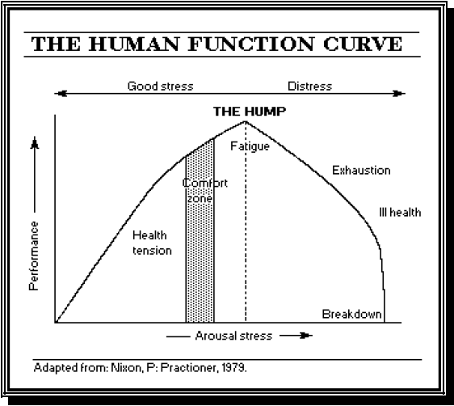
Too Much of a Good Thing
Notes:
Stress is good…. Until it isn’t

Slide 6
Continuum
Stress: The body’s natural reaction to demands
Burnout: reaction to prolonged high stress resulting in physical and mental exhaustion
Compassion Fatigue: depletion on physical, emotional, spiritual, intellectual and social levels
Notes:
Burnout
The loss of human caring
Emotional Exhaustion
Distancing Oneself
CF Syndrome
Energy and capacity to give is gone
Monkey in the Middle
“Delivering Self” as Product – giving out own energy
Vertically ill – Horizontally ill

Slide 7
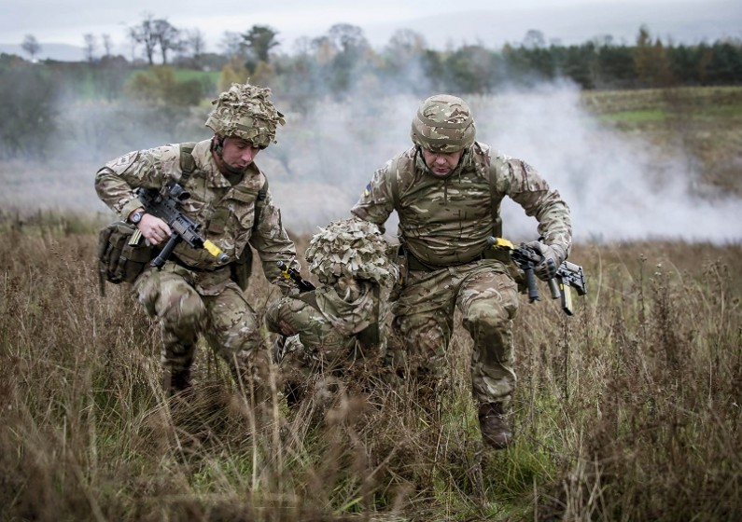
Trauma
Notes:
Events are traumatic but the ‘trauma’ is what’s held in the body and mind after those events have passed. We need to cultivate a different relationship with ourselves (Curiosity and self-compassion) to effectively handle stress and challenges. Ripple Effect. The Rubber Ducky.

Slide 8
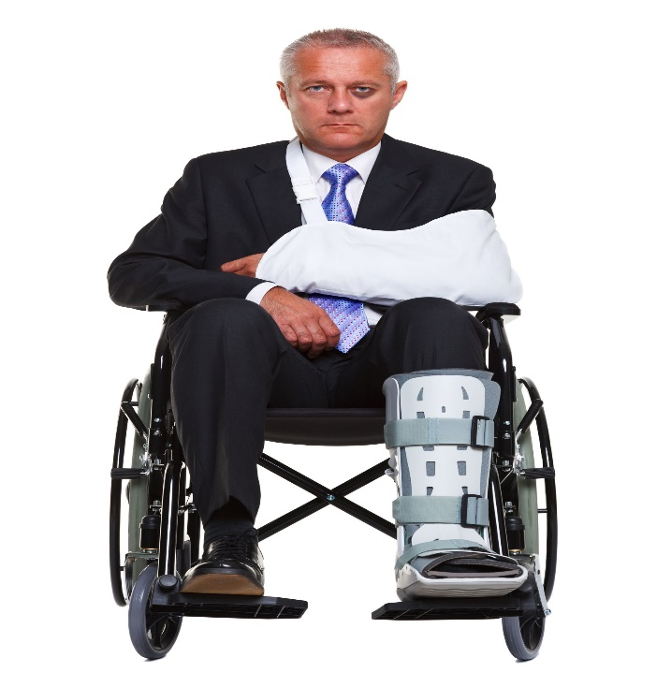

Trauma
Client Distress and Stories of Dire Circumstances

Slide 9


Trauma
Zero sum, Adversarial, Wanting to Fix, Integrity and Justice
Notes:
The ‘invisible and often insidious culprits of trauma: Fundemental beliefs challenged and often shattered.
Trauma impacts our ability to be present. Disconnection from self and others. It can be overt (avoiding) or covert (angry, rageful toward). We’re in our own storyline. Events are traumatic but the ‘trauma’ is what’s held in the body and mind after those events have passed. We need to cultivate a different relationship with ourselves (Curiosity and self-compassion) to effectively handle stress and challenges. Ripple Effect. The Rubber Ducky.

Slide 10
Burnout vs Compassion Fatigue: The Differentiator
Loss of Caring and Empathy
Feelings of lack of achievement
Lack of purpose and meaning
Loss of Hope
Sense of Powerlessness and Helplessness. “I can’t fix it.”
Disillusioned and detached. Feeling as in a fog. Numb and Empty.
Hardened Demeanor: Shattering of fundamental beliefs, integrity, justice
Interpersonal relationships. Disconnection from self and others.
Impacts Sense of Self and World View
Notes:
May look like Depression and/or anxiety.

Slide 11
Symptoms of Compassion Fatigue
Fight – Flight – Freeze: ‘The Body Keeps Score’
Work-Related: | Physical: | Emotional: | Spiritual:
Boundary violations: - Over-involvement with clients and their families - Under-involvement or disengagement in client care Reduced ability to feel empathy Lack of joyfulness Lowered morale | Headaches Digestive problems Muscle tension Insomnia Too much sleep Fatigue Chest paint, palpitations, elevated heart rate Impaired mental processes Weight loss/gain | Mood swings Restlessness Irritability Oversensitivity Anxiety Reliance on alcohol, illicit drugs Depression Anger and resentment Memory issues Poor concentration, focus and judgment | Loss of meaning Crisis of faith Loss of control Loss of self-worth Disconnection with people, work, community
Notes:
Let’s unpack the symptomology and take a look at where we may see ourselves:
I’m fine, workaholism
I can get thru it’ I’m a professional
Overachievers
Feeling underappreciated, getting resentful or Entitled- “I work SO hard, so I deserve: to shop, to drink.
Martydom
Notice and pay attention to our bodies – give us a lot of helpful information
Irritability, moodiness
Preoccupied at work, no energy, emotional, no satisfaction
Too tired, nothing more to give – being with others becomes a chore
Use of substances to cope, sleep, unwind
Tired of being with needy people
Start to lose our perspective
Hard to handle “negative” feelings – anger, resentment
“Not nice to have these emotions”
Msgs. we tell ourselves or that others tell us
Guilty feelings – shouldn’t complain
I’d want others to do this for me
Questioning – Am I doing enough? Am I being effective?

Slide 12


Let Yourself Off The Hook (SELF-COMPASSION)
It is an ADAPTIVE Response
Notes:
First and Foremost…. Please let yourself off the hook. It is an adaptive neurobiological response. And it can be managed/

Slide 13
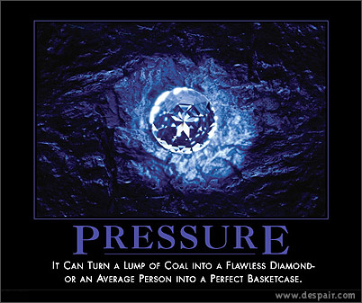
Work-Load
Notes:
Let’s point out the obvious…. ☺ There are environmental stressors that CANNOT BE CHANGED

Slide 14

Resilience: Protective Factor for Compassion Fatigue
NEUROPLASTICITY!
Can be developed
Allows you to be PRESENT with feelings
Gives permission to be human
AWARENESS
Notes:
Awareness (get curious) cornerstone of resilience. We are going to talk in greater detail about resilience. The main point here is that you want to give yourself permission to feel your feelings rather that avoiding or pressing them down. If we allow ourselves to truly feel our feelings it helps us move through stressful feelings more quickly. Sometimes as caregivers, we discount our feelings to demonstrate professionalism, however, the feelings still exist and need to be felt.

Slide 15

Elements of Resilience
Capacity to respond calmly and effectively in a crisis
Ability to tolerate distressing emotions
Flexibility to bend and flow with life
Skills and resourcefulness to move through difficulties
Courage
Able to find the lesson in failure
Allows for creativity and innovation
Notes:
The importance of resilience as a psychological concept began about 50 yrs. ago with the studies of adults who had endured severe difficulties in childhood, including parental loss, foster care, poverty, and all types of abuse. Elements of emotional functioning that predicted life success or failure were observed. The term that seemed to best characterize the ability to overcome adversity and go on to lead a successful like in adulthood is resilience. Over the years, the concept has been refined and utilized in therapeutic settings as well as in efforts to promote well being, emotional health and resistance to physical illnesses. Integration. Awareness of feeling to navigate challenges (Choice in the Pause)

Slide 16

Building Resilience and SELF-AWARENESS
SIMPLE. BUT NOT EASY
Body awareness
Cognitive awareness
Emotional awareness
Attending to intuition
Gut level warnings
What can you control, what can’t you?
Recognize the difference
Learn to BE in the HERE-AND-NOW
Notes:
The more self aware you are, the greater flexibility and creativity you will have in difficult situations. Pay close attention to bodily signals of anxiety, anger, uncertainty, fear, fatigue. Some times your gut will tell you when something isn’t right. Work to identify the feeling and how best to respond.

Slide 17

Strategies to Promote Well-Being
What helps you BE Calm & Present?
Know and honor your limits. Set Boundaries
Allow yourself to be human. Ask for help, it cultivates trust
Be an Empathic Witness for your colleagues
Do you have a Self-Care Plan? Nutrition, Exercise and Fun
Are you breathing? (Cultivate AWARENESS. It can change your brain!)
Self-Compassion: It’s a PRACTICE
Notes:
One attorney says, “This wears on all of us and on some of us more than others… but everyone suffers.”

Slide 18

To Refresh and Reinvigorate
BALANCE: Compassion Fatigue – Compassion Satisfaction

Slide 19

FUN
Discover Yours

Slide 20

FUN
Relaxed Wakefulness

Slide 21
Are You in a Healthy Zone?
Under Involvement | Zone of Helpfulness | Over Involvement
Professional Boundaries (Modified from NCSBN, Inc., Professional Boundaries 1996 Chicago, IL)
Notes:
Zone of Helpfulness: center of the professional behavior continuum; majority of interactions should occur here – for effectiveness & safety
Over-involvement: boundary crossings, boundary violations and professional misconduct
Under-involvement: distancing, disinterest, neglect; detrimental to client and caregiver

Slide 22

Take Care of Yourself
Notes:
Take care of yourself to take care of others
Eat right
Get enough rest
Drink water
Exercise
Find time to do what recharges your batteries
Avoid alcohol or other substances to cope with stress

