Slide 1
WCLA MCLE 10-10-2017
Young Lawyers’ Section
presents
Likes, Retweets and Tags
How Social Media is Filtering Workers’ Compensation
Tuesday October 10, 2017
12:00 noon to 1 pm
James R. Thompson Center Auditorium, Chicago, IL
1 hour general MCLE credit

Slide 2
Social Media Giants
Facebook
Post original content (statements, photos and videos) on your profile “wall” aka “timeline”
Link other social media accounts so that its content can appear on your wall
Check-in to locations
Add (“Follow”) colleagues, family, friends, businesses and public figures to your network (“Friends”)
Get updates and see your Friends’ posts on your “News Feed”
Comment on your Friends’ walls
Identify (“tag”) other Friends in photos, posts and comments
Send direct messages to Friends via Facebook Messenger
Create private or public events, send invitations, and accept/reject invitations to others’ events
Buy and sell items (“Marketplace”)
Snapchat
Users can send pictures, videos and messages that are only available for a short time before they become inaccessible
Users can send content directly to Friends or post a “Story” that can be limited to a specific network or made public
Twitter
Users post messages (“Tweets“) restricted to 140 characters (may soon be expanded to 280)
Follow other users, tag users in Tweets, and comment on or share (“Retweet”) other users’ Tweets
Instagram
Users post photos and videos
Follow other users, comment on their posts and tag users on posts/comments

Slide 3
Old But Not Dead
Myspace
Facebook competitor when Facebook was limited to university students
Its heyday was 2006-2009
In 2011, it rebranded itself as a music platform
Foursquare
Launched a companion app, Swarm, in 2014
Users can check in their location, thus sharing it with Friends
Users can search businesses, write reviews and post ratings
Users can search the location of Friends
Also Relevant
LinkedIn
Professional networking site
Users’ profiles read similar to a resume
Employers can post for job openings
Google +
Popular among photography enthusiasts
Tumblr
Users post multimedia short blogs (microblogging)
Users can follow others’ blogs on their “dashboard”

Slide 4
Why do we give a Tweet?
Vocational Rehabilitation
Respondent’s vocational rehabilitation counselor reviewed the claimant’s Facebook account and described the computer skills necessary to create and maintain such an account. She testified that those computer skills are transferable to basic office work such as data entry, file organization, and records management.
Meyer v. Illinois Workers' Compensation Comm'n, 2016 IL App (1st) 151549WC-U, ¶ 36 (where the appellate court affirmed the Commission’s decision that claimant failed to prove that she was totally and permanently disabled). Rule 23
DISCUSSION: Can we assume the claimant was using social media on a computer? What if the claimant’s use of social media was limited to the use of a smartphone or tablet? How are those skills transferable? What if the claimant relied on her children to use social media?
Facebook and Twitter no longer indicate whether posts came from a mobile device.
Temporary Total Disability
The arbitrator doubted whether the claimant was temporarily disabled since “the record shows he [was] able to conduct a significant number of internet auction sales [52 eBay transactions within 6 months] which include computer work, packaging and delivery of the packages to a shipper.”
Rodney Walker v. L&N Industrial, 2007 Ill. Wrk. Comp. LEXIS 643, *13, 7 IWCC 0322 (denying TTD benefits).

Slide 5
Why do we give a Tweet?
Credibility
The employer terminated the claimant for violating its sick day policy after finding photos on Facebook of the claimant at the Cubs game the day she called in sick.
Dundee Township Park District v. Illinois Workers' Compensation Comm'n, 2014 IL App (2d) 130150WC-U, ¶ 12 n.3 (where the appellate court upheld the Commission decision to award benefits finding the claimant credible). Rule 23
Although the Facebook post was a footnote in Dundee, it shows the consequences that can arise from social media.
The arbitrator found the claimant not credible when his testimony was contradicted by his Facebook postings. Although the claimant was only seeking TTD benefits through August 2013, the claimant testified that he did not return to work until May 2014. However, the claimant’s Facebook account included numerous check-ins at Sony with posts about working a third-shift prior to May 2014.
Christian Ortiz v. Eagle Contracting, 12 WC 41542, p. 11, October 26, 2016 (denying the claimant’s case on employer-employee relationship).
Social media videos are akin to surveillance footage
Assessing the claimant's credibility with respect to his/her capabilities and reported pain
Classic surveillance footage example: Lenhart v. Illinois Workers' Compensation Comm'n, 2015 IL App (3d) 130743WC, ¶ 35, 29 N.E.3d 648 (where surveillance footage showed the claimant performing yard work on several occasions and the appellate court affirmed the Commission’s decision that the claimant failed to prove that he was permanently and totally disabled).

Slide 6
DISCUSSION
How is a video obtained via social media any different than surveillance footage obtained by an investigator?
Relevance
Does the video show Petitioner engaging in activities outside his/her medical restrictions?
When was the video taken?
It is not necessarily when the video was posted on social media.
Exception: Facebook “live.”
Look at the medical records for the time frame when the video was taken.
Did Petitioner continue to report pain and/or difficulty with activities?
Was there any positive response to pain medication or other treatment?
Don’t forget about PT records!!!
Does the video show Petitioner engaging in any other activities affecting credibility?
Drug use, other illegal activity, or even questionable activity
Where’s the line?
DISCUSSION: Going back to written posts, if a print out of Petitioner’s Facebook wall containing multiple posts is admitted, how do you avoid the Arbitrator seeing irrelevant yet controversial posts? Redaction?
Admissibility
Foundation
Authenticity
Hearsay on any written posts, comments or captions

Slide 7
We Write How We Talk (at least on social media)
Anna Ash v. Illinois Veterans’ Home
Nursing assistant with two work injuries to right shoulder during patient transfers resulting in surgery (subacromial decompression) and permanent restrictions of no work above shoulder level.
To show that Petitioner (who owned horses) was engaging in activities beyond her permanent restrictions, Respondent turned to her Facebook page
Petitioner’s profile photo showed her holding a large horse's rope with her right arm.
She posted “getting ready to ride JD,” which was the name of a horse.
Petitioner explained that her husband rode the horses.
She also posted that “we picked up 86 bales of hay and now the boys are stacking them in the barn."
Petitioner testified that she sat in the truck while others picked the hay.
Other witnesses were called to testify to confirm Petitioner’s explanation.
Petitioner explained that she used the pronoun “we” to say that she was there, not to imply she engaged in the activity.
The Arbitrator found Petitioner to be credible.
Although there were several other issues in Ash, note the added time and energy Petitioner had to put in on the use of “we.”
2014 Ill. Wrk. Comp. LEXIS 1168, 14 IWCC 1130 (where Comm. Gore, Mathis and Basurto affirmed Arb. Lindsay’s decision to award benefits).

Slide 8
Don’t Assume Anything
Joseph Northington v. HTH Company
Respondent’s IME examiner, Dr. Butler, authored an addendum report reviewing surveillance footage and a Facebook post indicating that Petitioner went fishing. Dr. Butler opined that the Facebook post was inconsistent with what he had observed in the office.
The Facebook post was not from Petitioner’s account; it was his son-in-law’s account, Robbie.
Robbie posted the he went fishing with “my father-in-law.”
DISCUSSION: Regarding hearsay, what if Petitioner was tagged on Robbie’s post? What if the post then appeared on Petitioner’s wall? What if Petitioner failed to de-tag or remove the post from his wall? What if Petitioner then commented on Robbie’s post? When does the post become a statement by a party-opponent, if ever?
Petitioner testified that his son-in-law went fishing with his ex-wife's husband, Brent.
Robbie has more than one father in-law, including Petitioner and Brent.
The day when Robbie and Brent went fishing, Petitioner had appendicitis, went to the hospital and had his appendix removed.
Both Robbie and Brent were called to testify and confirmed Petitioner’s account.
The Arbitrator found the Facebook post to be irrelevant as the evidence established that Petitioner was not the father-in-law being referenced.
Again, while there were several other disputed issues, note the added time and energy spent on this Facebook post.
2016 Ill. Wrk. Comp. LEXIS 484, 16 IWCC 611 (finding claimant not credible and denying benefits for failing to prove an accident that arose in and out of the course of employment).

Slide 9
Damage Control
The Deception Of The "It's Just Personal" Perception*
Anything and everything is fair game
Complaints about employer and/or insurance carrier
Comments, postings or messages to, from or even about co-workers/management
Authorization/non-authorization of treatment
Don’t open the door but sometimes it’s not all bad (Re-direct)
Checking into medical facilities
Reporting complaints of pain
Posting about missing out on activities or events
Privacy Settings
What search results come up when you simply google Petitioner?
Your user name and profile picture on social media is normally public even if your account is set to private.
Even if your profile is private, photos of you from friends’ accounts may not be.
Is Petitioner friends with their co-workers or even management on social media?
Remind Petitioners not to accept Friend Requests from strangers.

Slide 10
https://help.instagram.com/116024195217477/?helpref=hc_fnav

Slide 11
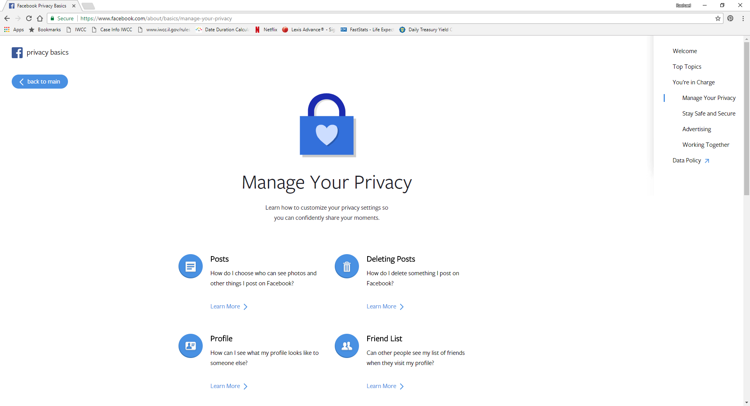
https://www.facebook.com/about/basics/manage-your-privacy

Slide 12
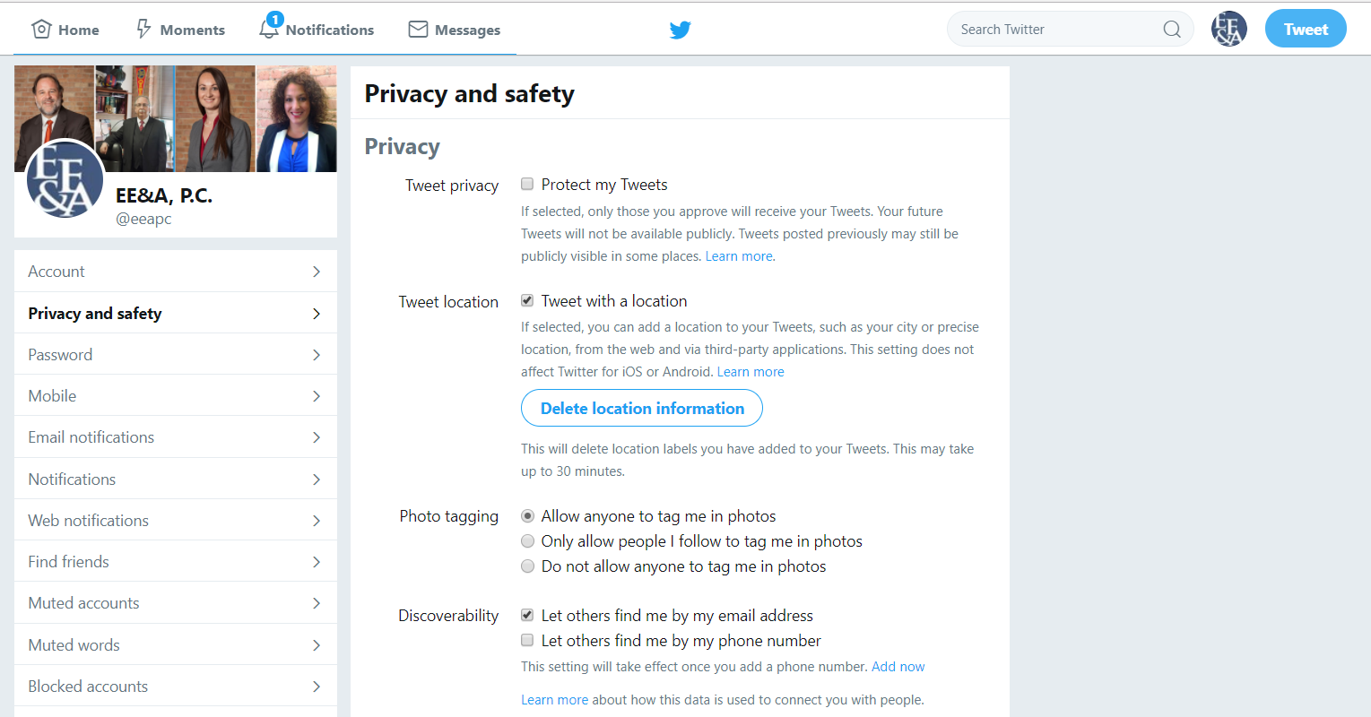
https://twitter.com/settings/safety

Slide 13
Illinois Rules of Evidence
Rule 901
REQUIREMENT OF AUTHENTICATION OR IDENTIFICATION
(a) General Provision. The requirement of authentication or identification as a condition precedent to admissibility is satisfied by evidence sufficient to support a finding that the matter in question is what its proponent claims.
(b)(1) Testimony of Witness With Knowledge. Testimony that a matter is what it is claimed to be.
(4) Distinctive Characteristics and the Like. Appearance, contents, substance, internal patterns, or other distinctive characteristics, taken in conjunction with circumstances.

Slide 14
Can’t I just issue a subpoena?
Good luck with that!
https://help.instagram.com/494561080557017
https://support.twitter.com/articles/41949
https://www.facebook.com/help/473784375984502
Most social media sites will only respond to valid search warrants or “equivalent from an agency with proper jurisdiction” over the social media site.
Even then, it’s an uphill battle and most responses will be limited to basic subscriber records such as subscriber name, account creation date, email address, and a signup IP address, if available.
Stored Communications Act, 18 U.S.C. § 2701 et seq.
Carpenter v. United States: Oral arguments before the Supreme Court are scheduled for the October 2017 term. The case concerns whether Fourth Amendment protections apply to cell phone “transactional records,” which reveal the location and movements of a cell phone. The case will reconcile a conflict between the long-standing “third party” doctrine and recent cases recognizing privacy interests in electronic data.
Facebook allows users to produce the content of communications from their accounts and by using Facebook’s "Download Your Information" tool.

Slide 15
Foundation
Is the exhibit a printout from the social media site from which it purports to be?
Does the printout accurately reflect the account as it appeared on the website?
When you see it, print it. Content can be edited or deleted.
Programs such as Snagit or Camtasia electronically capture and authenticate social media or other communications as they contain metadata (data regarding the creation of other data).
Ask your witness to establish that:
The witness visited the social media site and account in question and is familiar with its contents;
The witness recalls the appearance of the printout from the social media site; and
The witness recognizes the exhibit as accurately reflecting the contents from the social media site and account.
Did the post arise from the source (the particular person) that the proponent claims?
If the person in question denies writing a post, use circumstantial evidence:
Is the user’s profile picture a photo of the individual at issue?
Has the person at issue adopted the username shown on the profile page?
Is there any personal information on the profile page that is unique to the person such as date of birth?
Has the person shared his/her social media password with other people?
Imwinkelried, Edward. Evidentiary Foundations. 8th Ed. 2012. Print.
Schoen, D. (2011 May 17) The Authentication of Social Media Postings [Online article]. Retrieved from https://apps.americanbar.org/litigation/committees/trialevidence/articles/051711-authentication-social-media.html
Finkel, E. (2014 June). Building Your Case With Social Media Evidence [Online article]. Retrieved from https://www.isba.org/ibj/2014/06/buildingyourcasewithsocialmediaevid

Slide 16
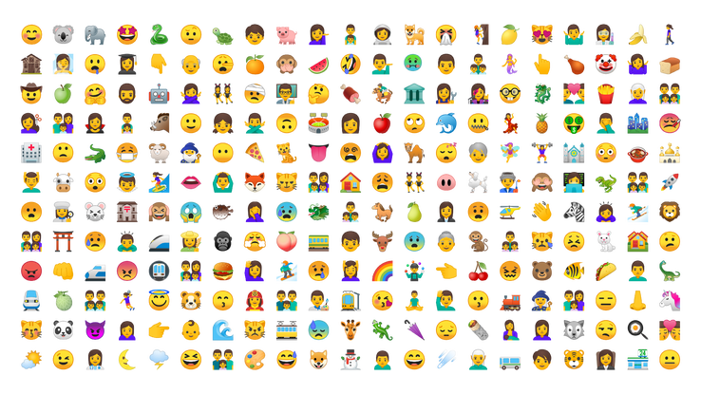
Congrats! The content is in evidence, but what does it mean?
The internet has its own language
Internet Acronyms
It’s not just “lol” and “brb” anymore
Ex. “WDUM” – What do u [you] mean?
Emoji
https://emojipedia.org/
Bitmoji
Users create a cartoon
avatar (usually in the user’s
image)
Don’t assume the
avatar reflects the user
Go back to foundation
#@$*

Slide 17
Social Media vs. Reality
Whether the exhibit accurately reflects the contents from a social media site and account does not mean the contents are an accurate reflection of reality.
“Insta Lie”
We often portray a version of ourselves as we want to be seen
Filters
Change the brightness and contrast of photos or add special effects
Boomerang
Takes bursts of photos and then stiches them together into a short video loop (up to 10 seconds)
The video distorts the speed and length of time in which the action is occurring
Boomerang is used in conjunction with Instagram but can be shared on other social media sites
An Instagram post will note if Boomerang was used
Photo Wonder
Photo editing and filtering app
DISCUSSION:
To discredit her complaints of low back pain, Respondent tries to introduces a Boomerang video shared on Petitioner’s Facebook in which Petitioner is dancing (twisting). Do the app’s features affect the video’s admissibility or only its weight?
Respondent tries to introduce still photos posted on Petitioner’s Instagram to lower the PPD value of her disfigurement case from a facial scar. Assuming the parties could not settle after a viewing and the matter proceeds to trial, would any social media photos be reliable? How could you tell if the photo was edited? What if a filter was used to enhance the appearance of the scar?

Slide 18
Questions?

